Slide 1
CMSC 449 Malware Analysis
Lecture 6
Host-Based Dynamic Analysis Tools

Slide 2
Host-Based Dynamic Analysis Tools
Goal of basic dynamic analysis is to investigate how malware interacts with the infected computer when run
Will break this down further:
How does malware interact with the host? (e.g. files, processes, registry, other configuration changes)
How does malware interact with the network?

Slide 3
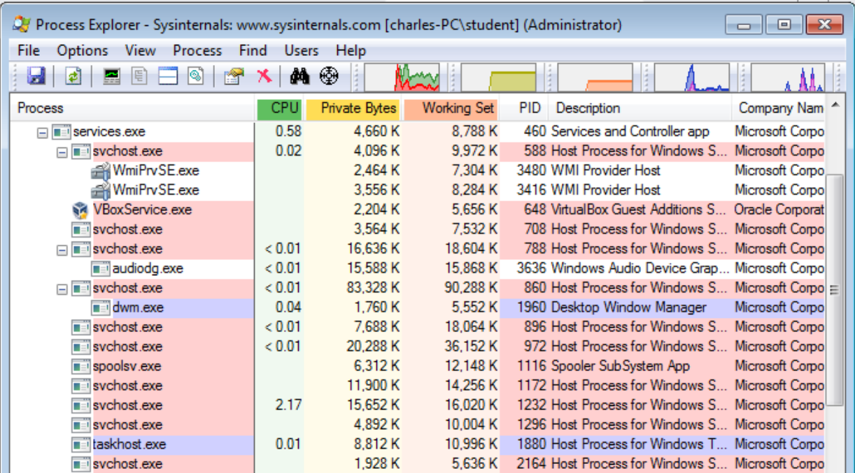
Process Explorer
Like a high-powered task manager tool
Great for inspecting processes that malware interacts with
Can see parent/child processes, strings in memory, DLLs loaded by a process, etc.

Slide 4
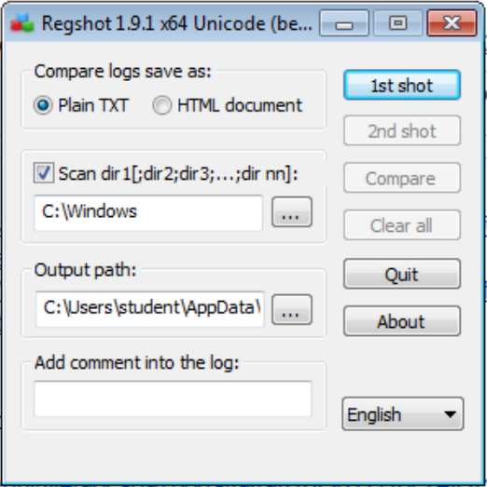
RegShot
Take a “snapshot” of the registry and filesystem
Then, run malware and take a second snapshot
Compare the difference to see what changes the malware made!

Slide 5
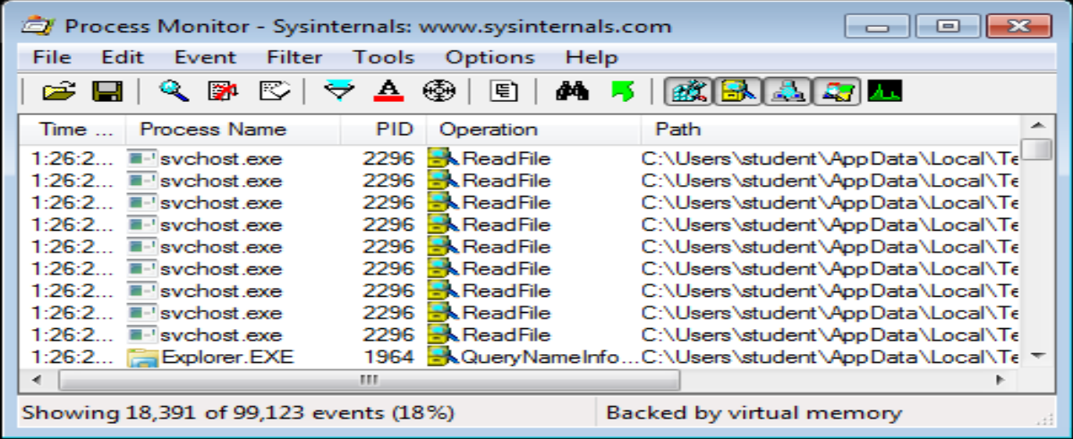
Process Monitor (ProcMon)
Inspect operations made by a running process
Creates huge amount of output – need to filter
You can run out of memory! Don’t leave it running too long
Can investigate most Windows API calls and their arguments

Slide 6
Basic Dynamic Analysis Demo
IllusionBot
Notes:
https://www.virustotal.com/gui/file/96ca097b0daff949826f3611116c7efc41343ad15cc76b96db1eeac3c01a3608/details (IllusionBot 2007)

